Slide 1


Malware Analysis Tools and Techniques
Examining malicious web pages and documents -1
Last Update: 26-11-18

Slide 2
Lesson Objectives
Learn the tools and techniques for investigating with malicious websites to assess the nature of their threats
Learn the tools and techniques to De-obfuscating malicious JavaScript using debuggers and interpreters

Slide 3
Malicious websites
Malware may propagate through the browser or operate within it.
Browser-based attacks may involve:
- Misusing the browser
- Privilege escalation
- Social Engineering
Need to understand browser technologies such as HTML and JavaScript.
VBScript, Flash and Java are helpful to know also.

Slide 4
Example: Browser Based Attack
A user was directed to a malicious website via a link included in an email message.
The website displayed an annoying JavaScript based animation
New windows popped up whenever the user closes one of the windows.
The victim could not close the windows fast enough and ended up turning off the PC.

Slide 5
Safeguard your system
Use lab systems that connect to the internet
Use VPNs or anonymizing proxies such as TOR and JonDonym
Use system and network monitoring tools if you connect using a full Windows system and browser.
Alternatively, download specific pages or files using tools such as wget and curl or online website such as https://www.httrack.com/

Slide 6
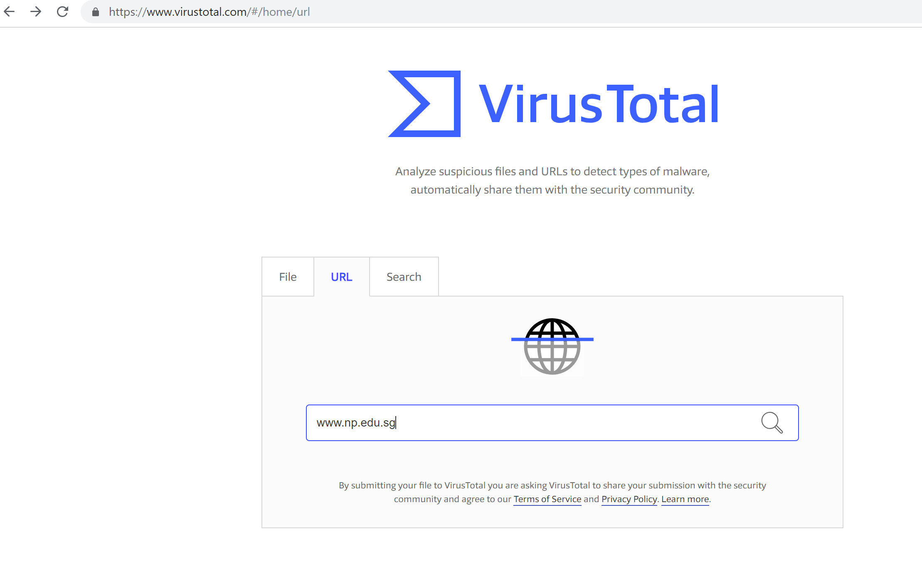
Checking for malicious website online
Use VirusTotal.com

Slide 7
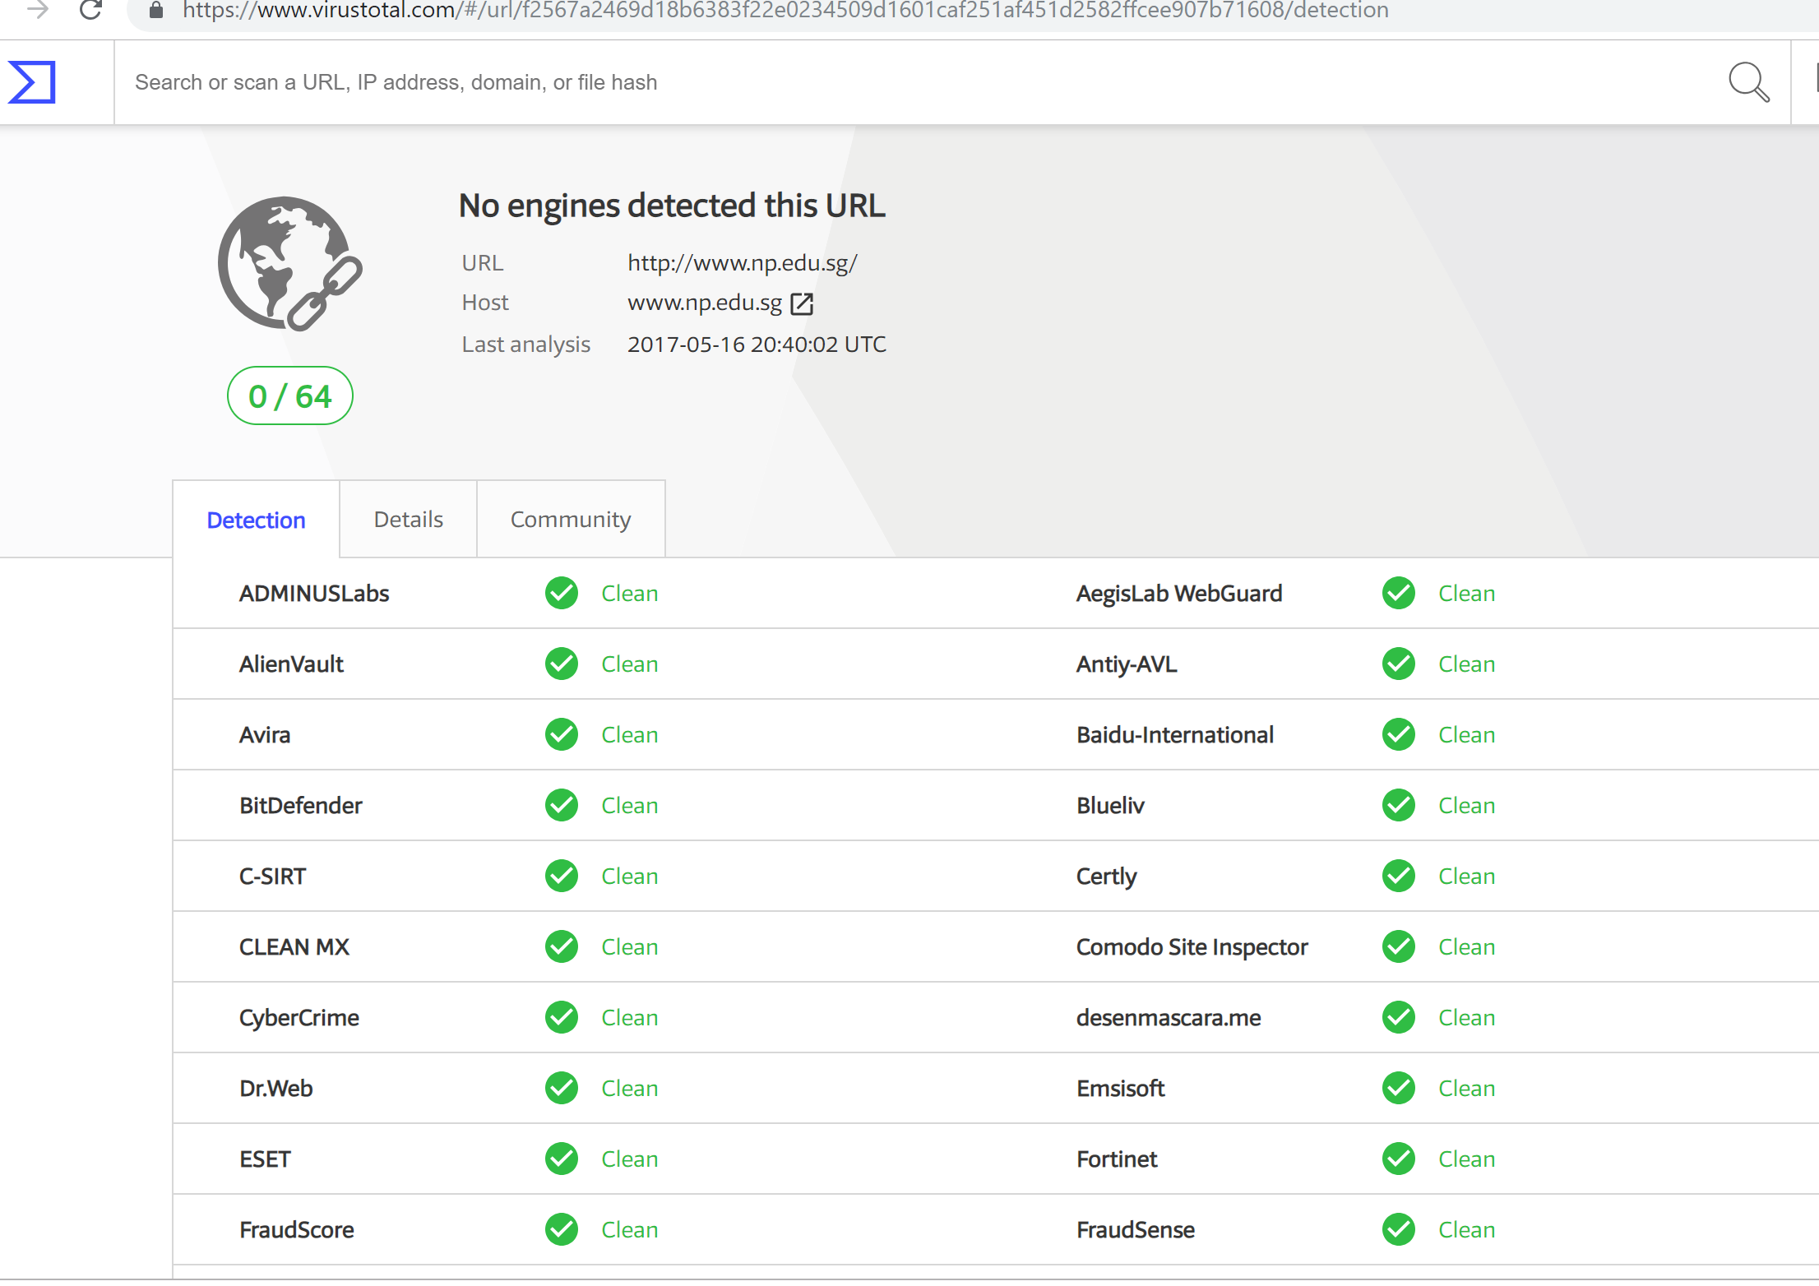
Checking for malicious website online

Slide 8
Deobfuscating Browser Scripts

Slide 9
Activity -15 mins
Step 1: Copy and paste this code in notepad:
<html>
<body>
<script language="javascript">
var _0xbfea=["\x59\x6F\x75\x20\x68\x61\x76\x65\x20\x77\x6F\x6E\x20\x61\x20\x67\x69\x66\x74\x20\x68\x61\x6D\x70\x65\x72\x2E\x20\x43\x6C\x69\x63\x6B\x20\x4F\x4B\x20\x74\x6F\x20\x63\x6C\x61\x69\x6D\x20\x74\x68\x65\x20\x70\x72\x69\x7A\x65\x2E"];for(i= 0;i< 100;i++){alert(_0xbfea[0])}
</script>
</body>
</html>

Slide 10
Activity
Step 2: Save the file as annoying.html
Step 3: Open the file in Chrome or any browser
What happens when you execute this file?

Slide 11
Analysing malicious browser scripts
Browser scripts help deliver exploits or redirect to other sites
The most common browser script is JavaScript
The scripts are often obfuscated (similar to packed Windows executables)
- avoid anti-malware detection
- complicates analysis tasks
You need to deobfuscate browser scripts, so you can examine them.

Slide 12
JavaScript Obfuscators
Most available commercial JavaScript obfuscators work by applying Lexical transformations (modify variable names)
There are many online JavaScript obfuscators such as https://javascriptobfuscator.com/Javascript-Obfuscator.aspx

Slide 13
Example:From Stunnix
Actual code:
function foo( arg1)
{
var myVar1 = "some string"; //first comment
var intVar = 24 * 3600; //second comment
/* here is
a long
multi-line comment blah */
document. write( "vars are:" + myVar1 + " " + intVar + " " + arg1) ;
} ;
Obfuscated code:
function z001c775808( z3833986e2c) { var z0d8bd8ba25= "\x73\x6f\x6d\x65\x20\x73\x74\x72\x69\x6e\x67"; var z0ed9bcbcc2= (0x90b+785-0xc04)* (0x1136+6437-0x1c4b); document. write( "\x76\x61\x72\x73\x20\x61\x72\x65\x3a"+ z0d8bd8ba25+ "\x20"+ z0ed9bcbcc2+ "\x20"+ z3833986e2c);};

Slide 14
Step by step examination
The Stunnix obfuscator targets at obfuscating only the layout of the JavaScript code
As the obfuscator parses the code, it removes spaces, comments and new line feeds
While doing so, as it encounters user defined names, it replaces them with some random string
It replaces print strings with their hexadecimal values
It replaces integer values with complex equations

Slide 15
Step by step examination
In the sample code that was obfuscated, the following can be observed
User defined variables:
foo replaced with z001c775808
arg1 replaced with z3833986e2c
myvar1 replaced with z0d8bd8ba25
intvar replaced with z0ed9bcbcc2
Integers:
20 replaced with (0x90b+785-0xc04)
3600 replaced with (0x1136+6437-0x1c4b)
Print strings:
“vars are” replaced with \x76\x61\x72\x73\x20\x61\x72\x65\x3a
Space replaced with \x20

Slide 16
Manual JavaScript deobfuscation
Lets deobfuscate the earlier JavaScript:
var _0xbfea=["\x59\x6F\x75\x20\x68\x61\x76\x65\x20\x77\x6F\x6E\x20\x61\x20\x67\x69\x66\x74\x20\x68\x61\x6D\x70\x65\x72\x2E\x20\x43\x6C\x69\x63\x6B\x20\x4F\x4B\x20\x74\x6F\x20\x63\x6C\x61\x69\x6D\x20\x74\x68\x65\x20\x70\x72\x69\x7A\x65\x2E"];
for(i= 0;i< 100;i++)
{alert(_0xbfea[0])}
The JavaScript contains 3 key elements: Variable, For Loop and an alert message.

Slide 17
Activity: Manual JavaScript deobfuscation
Create the following .html file using your notepad and open it in your browser:
<html>
<body>
<script language="javascript">
var _0xbfea=["\x59\x6F\x75\x20\x68\x61\x76\x65\x20\x77\x6F\x6E\x20\x61\x20\x67\x69\x66\x74\x20\x68\x61\x6D\x70\x65\x72\x2E\x20\x43\x6C\x69\x63\x6B\x20\x4F\x4B\x20\x74\x6F\x20\x63\x6C\x61\x69\x6D\x20\x74\x68\x65\x20\x70\x72\x69\x7A\x65\x2E"];
document.write(_0xbfea[0]);
</script>
</body>
</html>

Slide 18
Using tools to deobfuscate JavaScript
1. Clean-up the Javascript in question to make it easier to understand, and to enable better setting of breakpoints
2. Modify the Javascript to run in an interpreter (Firefox, Chrome, or command-line versions of the browser interpreter such as Spidermonkey or V8)
3. Run the code, modifying statements to include print statements or setting breakpoints

Slide 19
Some tools to deobfuscate JavaScript
JSDetox
Malzilla
JavaScript Deobfuscator
ExtractScript
JS-Beautifier
JS-Unpack
Rhino Debugger
Firebug
SpiderMonkey
V8
JSNice
PoisonJS

Slide 20
Tutorial
Check out the 11 Awesome Tools for Website Malware Scanning at https://geekflare.com/website-malware-scanning/
Understand the fundamentals of JavaScript at https://www.w3schools.com/js/
Check out some JavaScript obfuscators at http://javascript-reference.info/javascript-obfuscators-review.htm

